Slide 1

CADD – FPGA Architecture
Vinay Reddy
Department of Electronics and Communication
Engineering

Slide 2
Target Architectures

Slide 3
DESIGN FLOW
Application behaviour
Algorithm
Programming Optimisation Architecture Fabrication Device

Slide 4
TARGET ARCHITECTURES
Classification
Hard-wired
Full-custom or Semi-custom
Every new application, a new device
Programmable
PLA, PALs, FPGA
Functionality can be modified during deployment

Slide 5
Programmable Architectures

Slide 6
PROGRAMMABLE ARCHITECTURE
Programmable
Customisable even after the device is ready
Programmability
Compile time (One-time, Multiple times)
Run-time
6

Slide 7
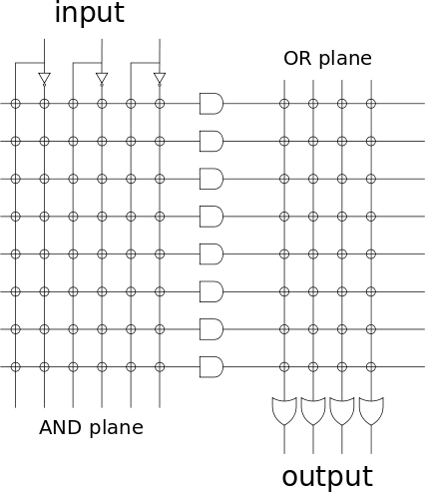
PROGRAMMABLE LOGIC ARRAY
PLA
Sum-of-Products Array
True and Complement
Programmable AND + Programmable OR
Programmable switches
Connect/disconnect
How?
Fuse electrically

Slide 8
PROGRAMMABLE ARRAY LOGIC
PAL
Sum-of-Products Array
True and Complement
Programmable AND + Fixed OR

Slide 9

COMPLEX PLDs
CPLD
Evolutionary next step to PLAs
Higher densities
Complex logic functions
Interconnection wires

Slide 10
FPGAs
Look-up table (LUT): Logic operations
Flip-Flop (FF): Stores the result of the LUT
Wires: Connect elements
Input/Output (I/O) pads: Data in and out of the FPGA.

Slide 11
FPGA ARCHITECTURE
Programmable Logic
Programmable Routing

Slide 12
LOGIC: LOOKUP TABLES
LUT
FF
₂K
SRAM
LUT
FF
2^{K}:1
MUX
LUT
FF
K
LUT
FF
Slice/Cluster

Slide 13
LOOK-UP TABLE
2^{K} SRAM Cells
₂K
SRAM
2^{2K} different functions
2^{K}:1 MUX
K-levels of 2:1 muxes
2^{K}:1
MUX
K

Slide 14
LOOK-UP TABLE: 2-INPUTS
2² SRAM Cells
₂2
SRAM
2²² different functions
2²:1
MUX
2²:1 MUX
2-levels of 2:1 muxes
2

Slide 15
LOGIC: SOFT
Programmable Logic
Blocks

Slide 16
LOGIC: HARD BLOCKS
Memory
Blocks

Slide 17
LOGIC: HARD BLOCKS
DSP
Blocks

Slide 18
LOGIC: LOOKUP TABLES
LUT
FF
₂K
SRAM
LUT
FF
2^{K}:1
MUX
LUT
FF
K
LUT
FF
Slice/ Cluster

Slide 19
OTHER TARGET ARCHITECTURES
Structured ASICs
In-between ASICs and FPGAs
Processors
Full-custom, but software programmable
System on Chips
Processors, ASICs, Programmable logic, …,

Slide 20
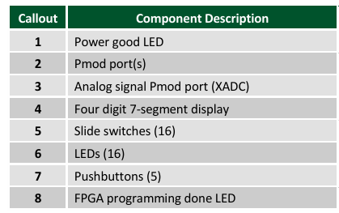
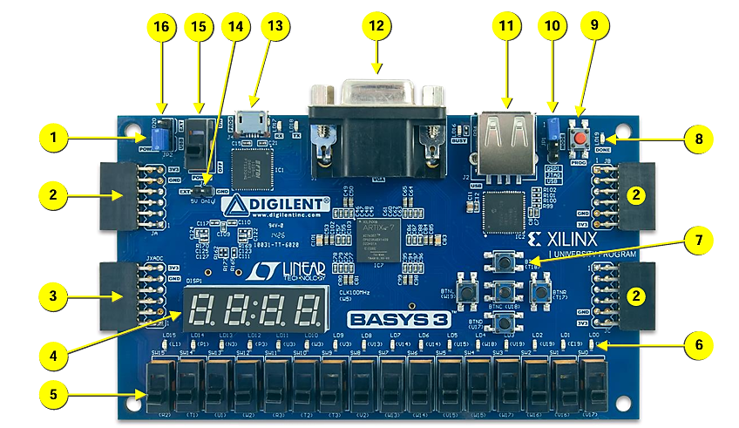
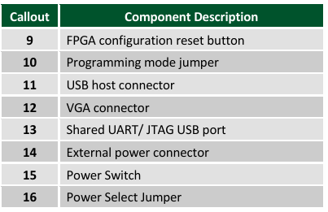
Basys 3 FPGA Board
The Basys 3 board is a complete, ready-to-use digital circuit development platform based on the latest Artix®-7 Field Programmable Gate Array (FPGA) from Xilinx®.

Slide 21
OTHER TARGET ARCHITECTURES
The Xilinx (now AMD) part number
XC7A35T-1CPG236C breaks down into specific characteristics of a Field-Programmable Gate Array (FPGA).
Here is what each section means:
XC: Standard commercial Xilinx product.
7: 7 Series architecture, based on a 28-nanometer process technology.
A: Artix-7 family, which is optimized for low-power and high-throughput applications.
35T: Specific device within the Artix-7 family. The "35" indicates it has roughly 35,000 logic cells, and the "T" denotes that it includes transceivers.
-1: Speed grade, which is a performance indicator. For Xilinx, a smaller number typically means a lower speed and cost, while a higher number (e.g., -2 or -3) indicates higher performance.
CPG236: The package type and pin count. "CPG" specifies a 0.5 mm pitch Chip-Scale Ball Grid Array (CSBGA), and "236" refers to the number of solder balls (pins) on the package.
C: Temperature grade, indicating a commercial operating temperature range

